Slide 1
Welcome to this Briefing for PCC Secretaries
October 2017

Slide 2
Programme
Introduction Archdeacons Mark and Michael
The PCC Secretary – overview of role – Gillian Beeley, Kelly Quinn (Archdeacons PAs)
For the record – returns, policies, registers
Elaine Hargreaves, Dave Champness, Kelly Fenwick
Presentation on Websites – Dave Champness
Questions
Closing comments Archdeacons

Slide 3
The Role of the PCC Secretary
Church
PCC secretaries’ handbook
PCC Meetings
Annual General Meetings
Useful information

Slide 4
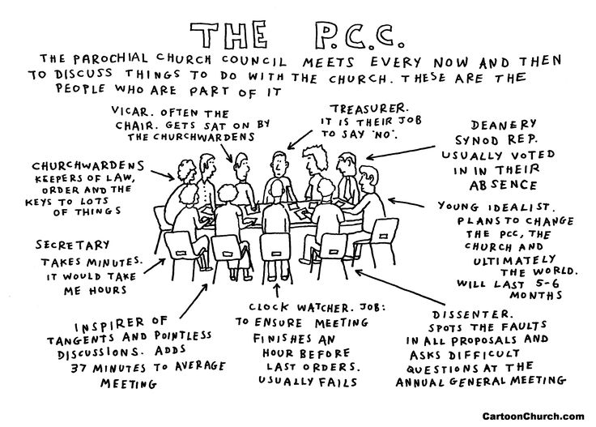

Slide 5
PCC Meetings
Church Representation Rules 2017 – on line
Min 4 meetings per annum
Notice issued min 10 days before, Agenda 7 days before the meeting
Minutes – if possible issue draft minutes within 2 weeks of meeting to PCC
Templates available
Keep minute/document book – should be kept in safe!

Slide 6
The Church Year
Annual Meeting of Parishioners (to elect wardens)
Annual Parochial Church Meeting by April 30th
First PCC meeting elects Treasurer and Secretary
Consider timings of all returns and ensure on agenda accordingly (see matrix on website)
December (Accounting year end) – start to consider year end schedule, date for APCM
February – prepare for elections of wardens, other office holders, Annual Report/ Accounts to PCC
March – prepare paperwork for Annual Parochial Meeting – notices etc.

Slide 8
The Annual Parochial Church Meeting
All reports approved by the PCC before APCM
Receives the annual report and accounts
Election of PCC, sides people
Hear the views of the parish
Report on changes in membership of electoral roll
Report on fabric, goods etc
Report on proceedings of deanery synod
Appoint independent examiner or auditor to PCC (someone not on PCC)
AOB – anyone can ask any question!

Slide 9
Some helpful resources
http://www.parishresources.org.uk/
http://www.parishresources.org.uk/pccs/apcms/
https://www.john-truscott.co.uk/Resources/Administration
Church Representation rules http://www.legislation.gov.uk/ukcm/1969/2/contents
https://www.blackburn.anglican.org/pcc-secretary-or-administrator - PCC Secretary’s Handbook
Behrens – Practical Church Management ed 3 2014
Or ask Gillian or Kelly – 01254 958836

Slide 10
Further Briefings
For Treasurers
  11 November – Torrisholme
  18 November – Clayton House, Blackburn
  Dates to be arranged …. details to be advised
  Safeguarding, Looking after your buildings, HR – Looking after your employees and volunteers

Slide 11
Thank you for your time and commitment
If you have any comments, want further information, or especially to share your good practice,
please email
either of the Archdeacons or their secretaries
or ring
01254 958836

Slide 12
ALL
Heavenly Father, we embrace Your call
for us to make disciples,
to be witnesses and to grow leaders.
Give us the eyes to see Your vision,
ears to hear the prompting of Your Spirit
and courage to follow in the footsteps of your Son,
our Lord and Saviour Jesus Christ. Amen

